Slide 1

MBAS904:Business Analytics Project
Chinmay Datar Shruti Jawale
6956361 6922557
Notes:
Hello. This is our MBAS904 presentation based on ‘insight toy demo’ dataset.

Slide 2
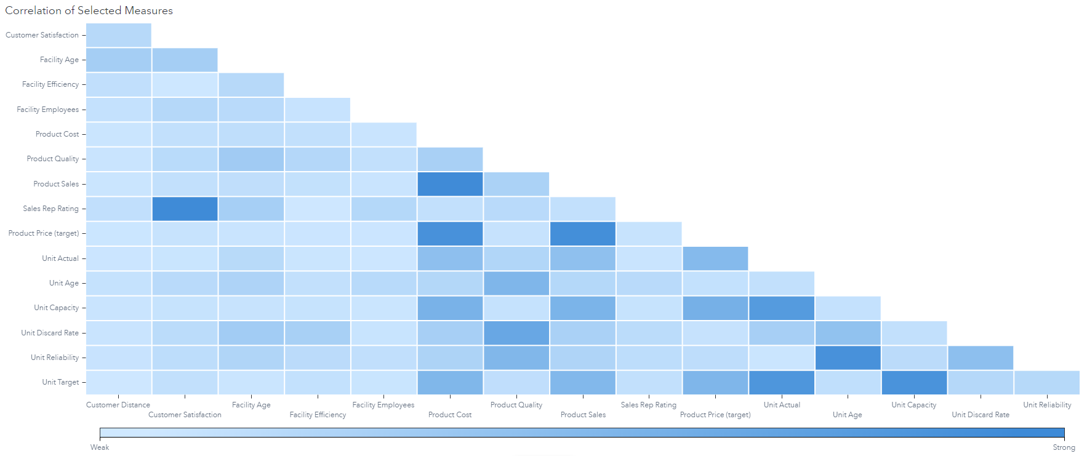
Correlation Matrix
Notes:
To start looking at the data we start with creating a correlation matrix which will help us understand what variables have strong to medium correlation. This will help us understand what columns to use for visualising the data in different dashboards. We can see several strong correlations in the matrix such as customer satisfaction with sales rep rating, product cost with product sales, ,unit efficiency with unit reliability, etc. We will look into all these correlations as we go ahead.

Slide 3
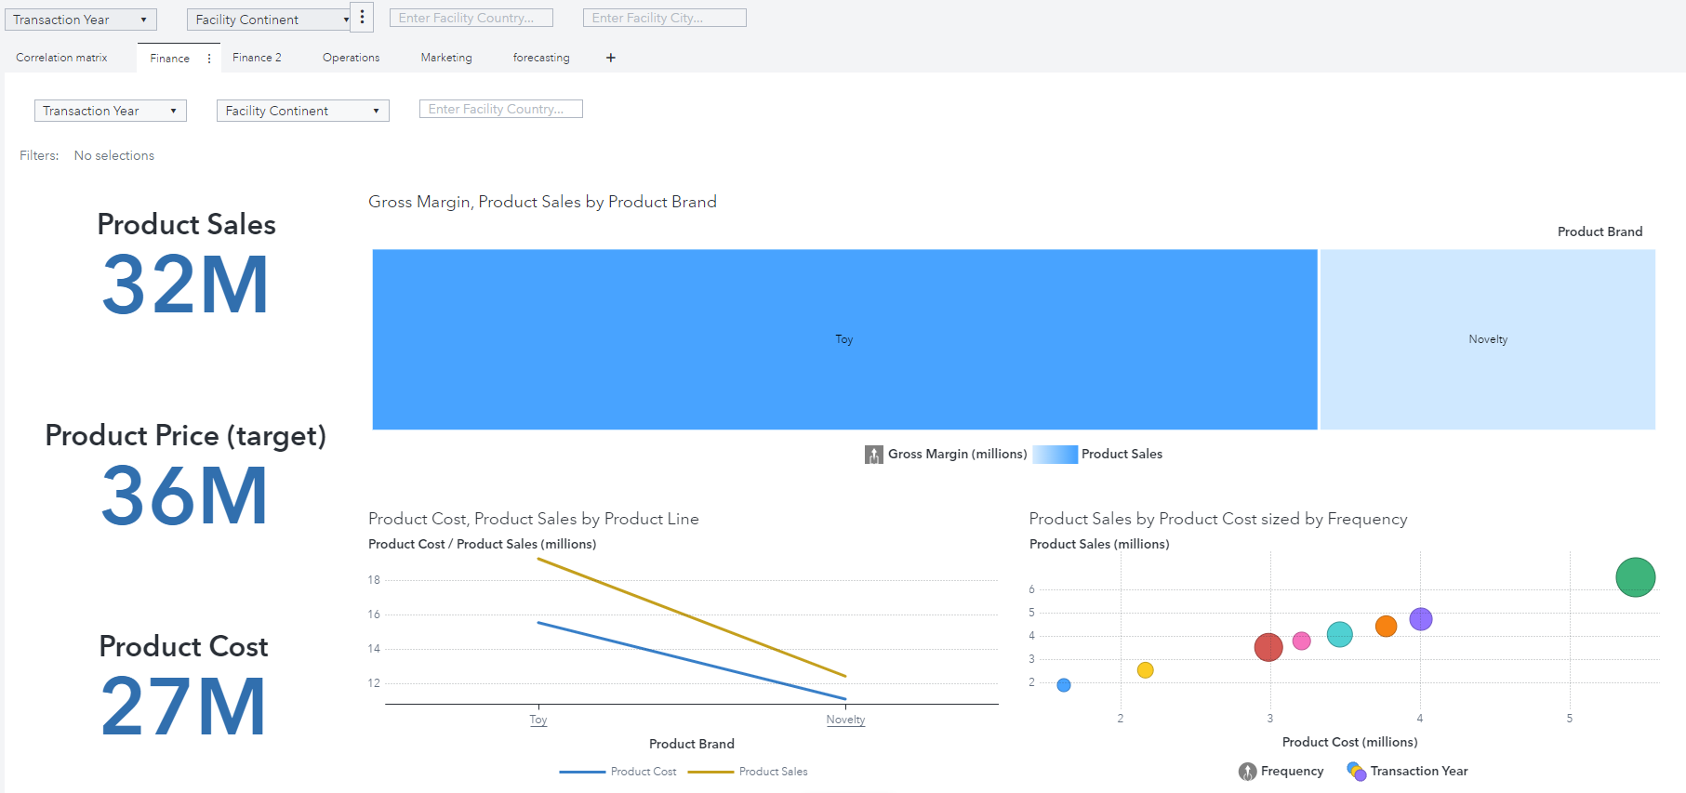
Financial Report 1
Notes:
Lets start with Financial Report. The first thing to notice is toys have much higher sales revenue and higher gross margins. When we double click on Toy in the line graph we see that plush toys have the highest gross margin. We further see in the bubble chart that 2004 has the highest sales and highest number of products sold. We also see a linear pattern in between product sales and product costs. It also shows the company is consistently producing higher profits every year and with less number of products.

Slide 4
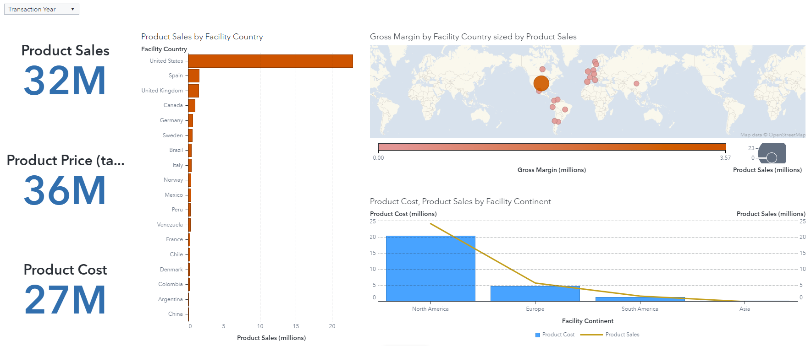
Financial Report II
Notes:
In the second financial report we see sales and costs by their geography. We see that United States clearly has the highest sales, gross margins and number of products sold. United States has more than 20 times more sales than the next country. And North America has more than 5 times the sale of Europe with less gross margins. Asia has the lowest sales with only 2million in gross margin.

Slide 5
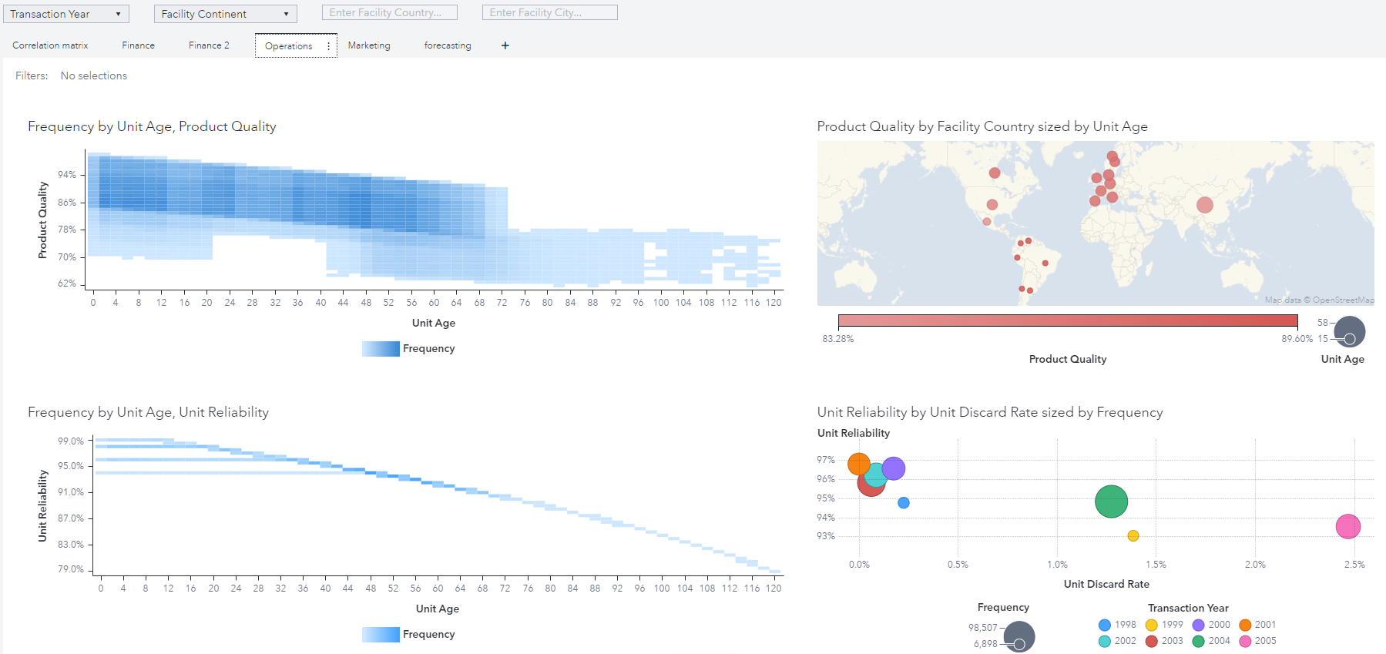
Operations Report
Notes:
Lets move on to operations. In the operations dashboard the heatmaps visualize the relation with product quality and unit reliability with unit age. We see a negative relation between the 2. Product quality is seen to be consistently decreasing with dropping heavily after 72 years to 78%. This leads to drop in unit reliability due to poor products. The second heatmap shows the same. The bubble plot on the right shows the relation between unit disregard rate and unit reliability. After 1999 the unit reliability increases to 97% which could mean the company changed their Machineries in the year 2000. In the map we can see most of the European and North American units are old and hence the product quality is lower while units in South American countries are new and hence produce products with higher product quality than other countries.

Slide 6
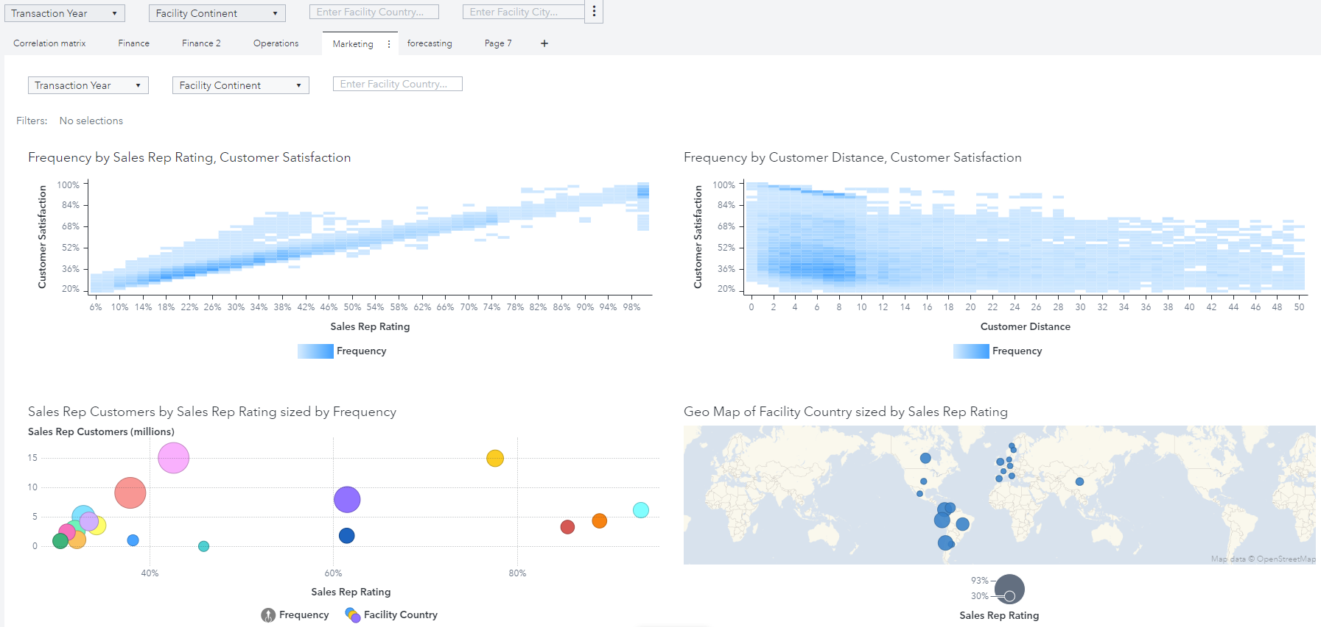
Marketing Report
Notes:
Next lets look at the marketing dashboard. In the heatmap we see that sales rep rating has positive correlation customer satisfaction and a negative relationship with customer distance. It can be noted that customers with low satisfaction tend to leave a rating as opposed to customers with higher satisfaction. Customers who live closer to the outlet are generally more satisfied than people who live further away. Although customers’ satisfaction who live the closest range from 30% to 100% but people with satisfaction of level 50% of less tend to leave reviews more times than customers who are more satisfied.
In the geographic map and bubble plot we visualise how sales rep rating affects the number of customers they bring. It can be observed that there is positive correlation between the 2. Although most countries’ average sales rep rating is less than 40%. Only countries in South America and Canada have average sales rating of 60% and they have higher sales which shows that customers in these country value sales rep rating more than other countries.

Slide 7
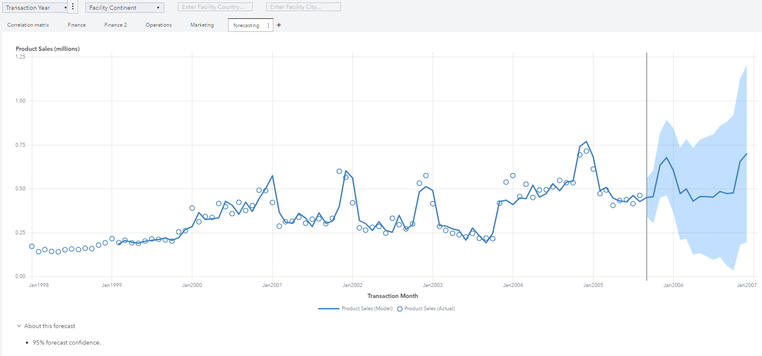
Sales Forecasting
Notes:
Based on the information we have we created a sales forecast to the end of next year. The forecasting model forecasts with 95% confidence. Yearly trends show that sales dramatically increase in the month of December. This can be attributed to the holiday and gifting season. And the forecast follows similar pattern as 2004. product sales in the month of 2006 are predicted to go up to 700 hundred thousand dollars out of which about 40% are expected to come from United States.
The company has units in only one country in the Asian subcontinent. Insight Toy needs to expand its operations and sales in other Asian countries in order to create higher profits. They also need to update their machinery in the European countries. The units need to be run at an optimized capacity instead of maximum capacity in order to produce higher quality products for a longer period of time.

Slide 8

Thank You
Notes:
Thank You for litening

